Slide 1


Slide 2
JAVA INTRODUCTION

Slide 3
WHAT IS JAVA?
Java is a high-level programming language originally developed by Sun Microsystems in 1995.
Java is a platform independent language.
The Java language’s programming is based on the concept of OOP.
Most of Java Syntax are based on C/C++.
It is a widely used robust technology.

Slide 4
TYPES OF APPLICATION CAN CREATE
There are mainly 4 types of applications
→ Standalone Application
→ Web Application
→ Enterprise Application
→ Mobile Application

Slide 5
EXAMPLES
Desktop Applications such as acrobat reader, media player, antivirus, etc.
Web Applications such as irctc.co.in, javatpoint.com, etc.
Enterprise Applications such as banking applications.
Mobile
Embedded System
Smart Card
Robotics
Games, etc.

Slide 6
JAVA FEATURES
Simple
Object-Oriented
Platform independent
Architecture neutral
Interpreted
Multithreaded
Distributed

Slide 7
JDK, JRE AND JVM
JDK – JAVA DEVELOPMENT KIT
Develop, compile and execute (run) new applications and also we can modify existing applications.
JDK includes JRE and development tools.
JRE – JAVA RUNTIME ENVIRONMENT
The Java Runtime Environment is a set of software tools which are used for developing Java applications.
It is used to provide the runtime environment.
It contains a set of libraries.
JVM – JAVA VIRTUAL MACHINE
It is a specification that provides a runtime environment in which Java bytecode can be executed.
The JVM performs the following main tasks:
- Loads code.
- Verifies code.
- Executes code.
- Provides runtime environment.

Slide 8
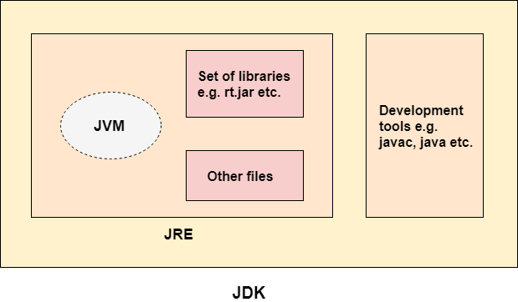

Slide 9
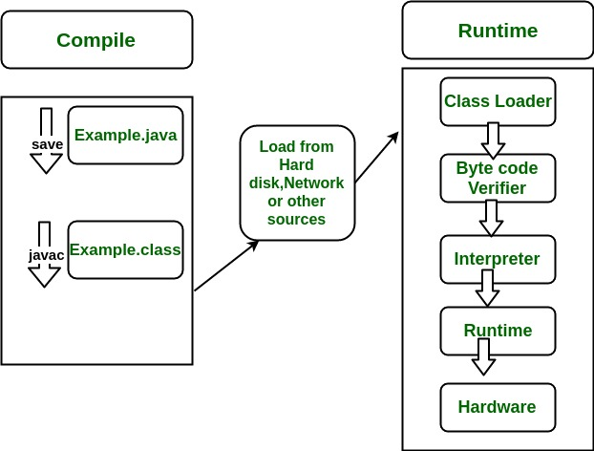
INTERNAL WORKING

Slide 10
MODIFIERS
Java provides 2 different types of modifiers
Access Modifiers
Non – Access Modifiers
Access Modifiers
The access modifiers in java specifies accessibility (scope) of a data member, method, constructor or class.
Types of Access Modifiers
- private
- default
- protected
- public

Slide 11
Non – Access Modifiers
Java provides a number of non-access modifiers to achieve many other functionalities.
Types of Non – Access Modifiers
- Static
- Abstract
- Final

Slide 12
OPERATORS IN JAVA
Arithmetic Operator
Relational Operator
Logical Operator
Unary Operator

Slide 13
JAVA EDIDTORS
Net Beans
IntelliJ IDEA
Eclispe
Jdeveloper
Dr. JAVA
BlueJ
JCreator
JGrasp
Greenfoot
Codenvy

Slide 14
Second Day Topics
Variables
Data Types
Control Statements
Classes & Objects

Slide 15
Mohammed Khan
7395975829

Slide 16
THANK YOU

